Slide 1
Transit for sustainable cities
Onika Morris-Alleyne

Slide 2
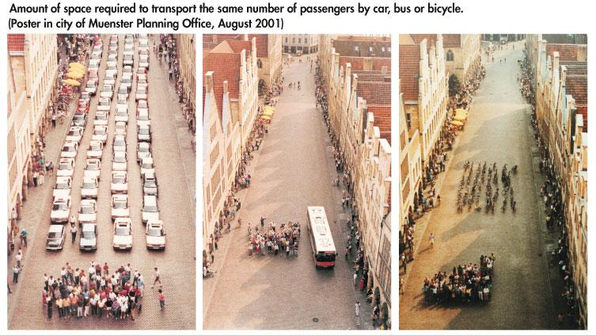
What transportation planning can do…

Slide 3
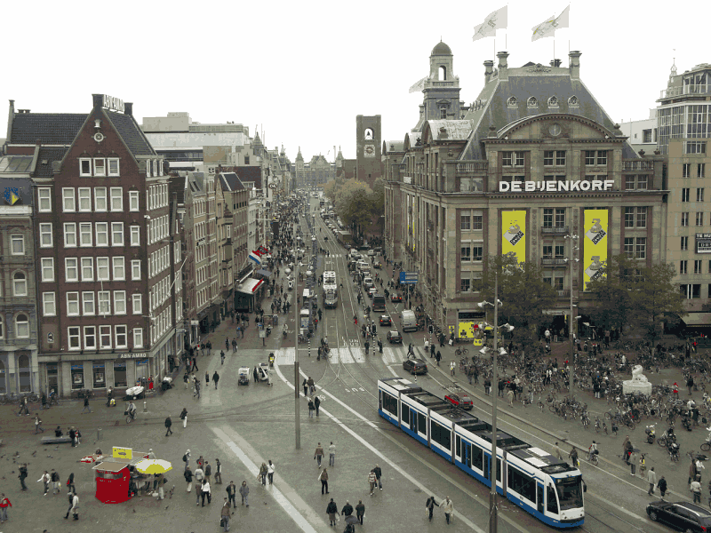
What transportation planning can do…
Notes:
Dam Square, Amsterdam
Why should anybody care about transportation planning? Why should YOU care about transportation planning?

Slide 4
Thesis statement
Sustainable transport systems are about the technology you use, and the modes you choose, but they are also, and I believe more importantly about:
the headspace in which planning takes place
the policy that emerges from that headspace, and
the culture of mobility created by following that policy.
Notes:
Issues in transportation
Congestion
Emissions
Health
Safety
Security
Social inclusion

Slide 5
But first...

Slide 6
Policy, planning and systems
Transport policy
Performance evaluation and feedback
Sets values, objectives, constraints and rules of engagement
Land use and transport planning
Performance evaluation and feedback
Establishes levels of demand, setting operating conditions
Transport system
Notes:
Transportation systems don’t exist in a vacuum.
macro: national level. what is the strategy?
meso: regional/institutional level. how do we break down the strategy into plans?
micro: local level. how do we implement the plans?

Slide 7
The headspace
Guiding principles for policy development

Slide 8
Plumber’s questions
What are your values?
What do you want?
What do you need?
Why?
Whom are you serving with transit?
How do you achieve “it”?
Notes:
What are the “plumber’s questions”? This is an example from Jarrett Walker’s book “Human Transit” which I refer to as my bible. It is a very good basic reference primer, and Walker also has a blog www.humantransit.org that is good reference material. So the “plumber’s questions”. Let’s say you hire somebody to fix a leak. He takes a look at it and says ‘Aight, hear what. For $200, I could patch it up now with some flashband, and it go stay good about six weeks, but then it will start to leak again, probably worse. The other option is that I can take out the whole thing and replace it so it’s like new, and it will last for about 10 years, but that will cost about $2000 and I will have to order the part, that will take about a week to come and about 2 days of work once the part reach.” The plumber can only present you with options, and tell you the consequences of each option. He cannot choose for you, because he doesn’t know what your needs are, what your finances are like or how urgently you need the leak fixed, but once you choose, he can handle the repair.
So what are the problems of cities that we’re trying to solve with public transport?

Slide 9
Externalities:
the problems to be solved
Systems out of balance, where supply exceeds demand, or demand outstrips available supply, create issues, referred to as ‘externalities’.
Notes:
The problems we’re attempting to solve are called transport externalities

Slide 10
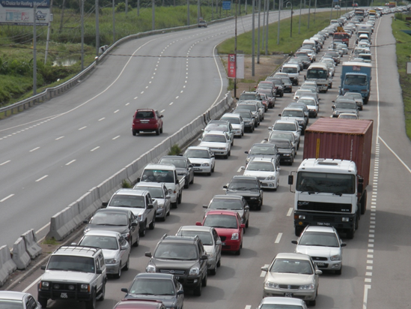
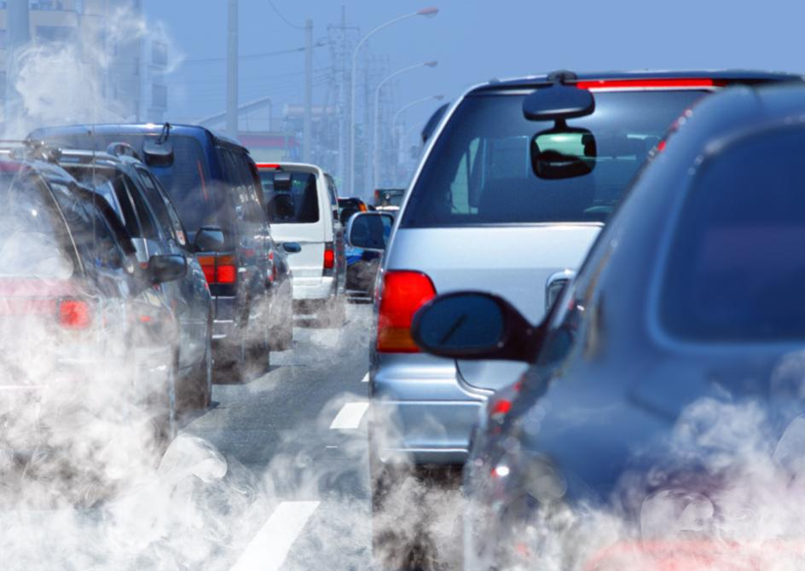
Externalities:
the problems to be solved
Notes:
Transport issues:
Congestion
Emissions
Health
Safety
Security
Social inclusion/exclusion
Overcrowding
Underservice
Pedestrian problems
Environmental impacts and accidents
Parking problems

Slide 11
Externalities:
the problems to be solved
Notes:
The problems we’re attempting to solve are called transport externalities

Slide 12
Empathy in problem-solving
How would my experience be different if I were:
- taller...
- shorter...
- wearing a skirt...
- blind...
- deaf...
- travelling alone at night...
- travelling with small children...
- illiterate...
- living in Moruga...
- not fluent in English...
- in a wheelchair...
Notes:
As planners, we must make special effort to consider needs as broadly as possible. This requires us to constantly put ourselves in the shoes of others. Always ask the question “What if I weren’t me?

Slide 13
Technical guiding principles:
Making MAS
Mobility: movement
Accessibility: connection
Sustainability: stewardship
Notes:
Mobility: The ability to travel freely wherever we might want to go; ease of free movement
Accessibility: The ability to get the things we want and need; ease of reaching goods, services, other people and information
Sustainability: The ability to meet the needs of the present without compromising the ability of future generations to meet their own needs.

Slide 14
Questions in mobility
How is our population moving around?
How much is our population moving around?
How fast is our population moving around?
What is it costing our population to move around?
Notes:
Indicators:
Trips per capita
Mode split/share
Average trip distance
Average trip time
Vehicle distance per capita
Passenger distance per capita
Vehicle boardings per capita
User costs

Slide 15
Questions in accessibility
Can our population access transport?
Can our population access what they need with the transport available to them?
Is there equitability and efficiency in the distribution of transport to our population?
Notes:
Entire field called accessibility planning
Promote social inclusion
Eliminate/mitigate discrimination
Support independent mobility
Remember transport includes access at the beginning and end of journeys as well as during
Concessionary fares, dial-a-ride services, accessible vehicles
EMPATHY
Special groups: Seniors
Students/minors
Women
Disabled/mobility challenged
Rural communities
Illiterate

Slide 16
Questions in sustainability
Can we afford this level of mobility?
Is this level of mobility negatively affecting our environment?
Can we maintain this level of mobility? Should we?
What are the effects of our choices? Will future generations be free to make the choices they need to make?

Slide 17
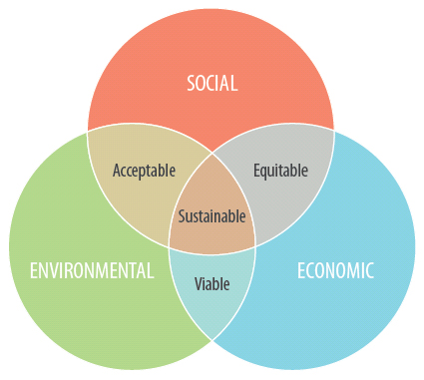
(A note on sustainability)
Notes:
You will see some other models and additional dimensions included in these, but this model is the one I have found most useful for introductory work. Profit, people, planet model.
Env: Conservation of natural resources
Maintaining the physical surroundings for the health and well-being of society
Efficient and effective use of natural resources, both non-renewable and renewable
Econ: Efficient and effective use of financial resources
Conservation and improvement of economic systems and drivers
Soc: Knowledge transfer
Institutional development and strengthening
Record-keeping
cultural: have we done the necessary work to effect shift in the population’s thinking and behaviour

Slide 18
The policy
Guiding principles for culture change

Slide 19
Shaping policy
The Environment
Policy
Our Transport Policy is…
Experience
Important to us: Improved public health
Notes:
What does that mean? Policy is not ‘one-size fits all’. Policy developed for one society may not be workable in another society. the constraints may be different, the resources may be different, the society may be different.
Worldview, principal beliefs, causal stories
Examples, knowledge transfer, case studies
governance structure

Slide 20
Policy context:
PESTLE factors
Political: interest groups, popularity, credibility, public trust
Economic: finances, general economy
Social: demographics, cultures and behaviours
Technical/Technological: available technology and technical knowledge
Legal/Legislative: institutional structures and regulatory frameworks
Environmental: development patterns, topography, land use

Slide 21
Policy experience:
Investigation
Where else has policy like this been applied? What was the outcome?
Why does the same policy have different outcomes in different places or for different people?
How do things become best practice? How does best practice become common practice?
Why do we make the same mistakes?
When developing, implementing and evaluating policy, quite often the question to ask is not WHAT happens, but WHY it happens.

Slide 22
Policy experience:
Appraisal
Is it effective?
Is it cost efficient?
Is it practical?
Is it acceptable/reasonably popular?
Is it fairly distributed?
Is it legal?
What are the side effects?
Notes:
Is it effective?
against objectives
against BAU/‘do nothing’
Is it cost efficient?
value for money
Is it practical?
affordability
capacity to deliver
enforceability
Is it acceptable/reasonably popular
public
political
Is it fairly distributed?
discrimination
fairness
Is it legal?
laws of the land and international law
international treaties
What are the side effects?
issues
PESTLE factors

Slide 23
Policy integration
No useful transport policy process can happen without broader inclusion. This is called policy integration, and happens both ‘horizontally’ and ‘vertically’.
Horizontal or functional integration requires working across different fields of knowledge.
Vertical integration requires working both up and down the institutional ladder.
Policy is only implementable when the right idea with support from the right mix of interests is taken up by the right person in the right position at the right time.

Slide 24
The culture
Getting people on board

Slide 25
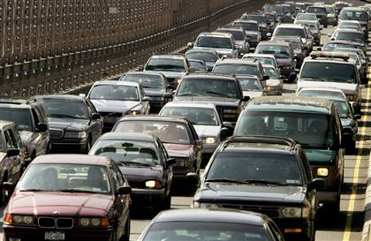
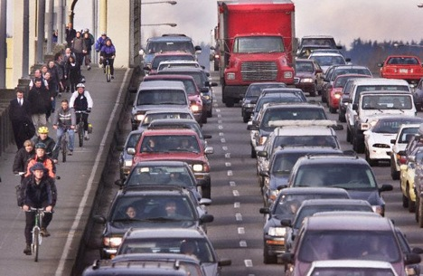
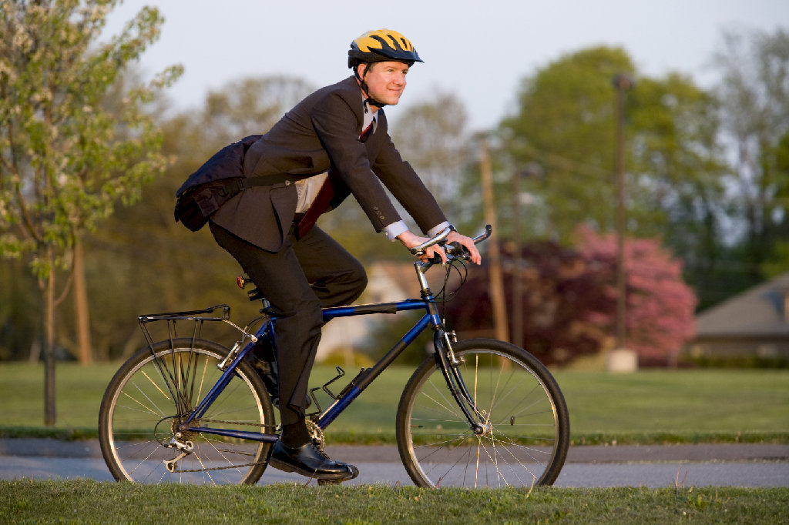
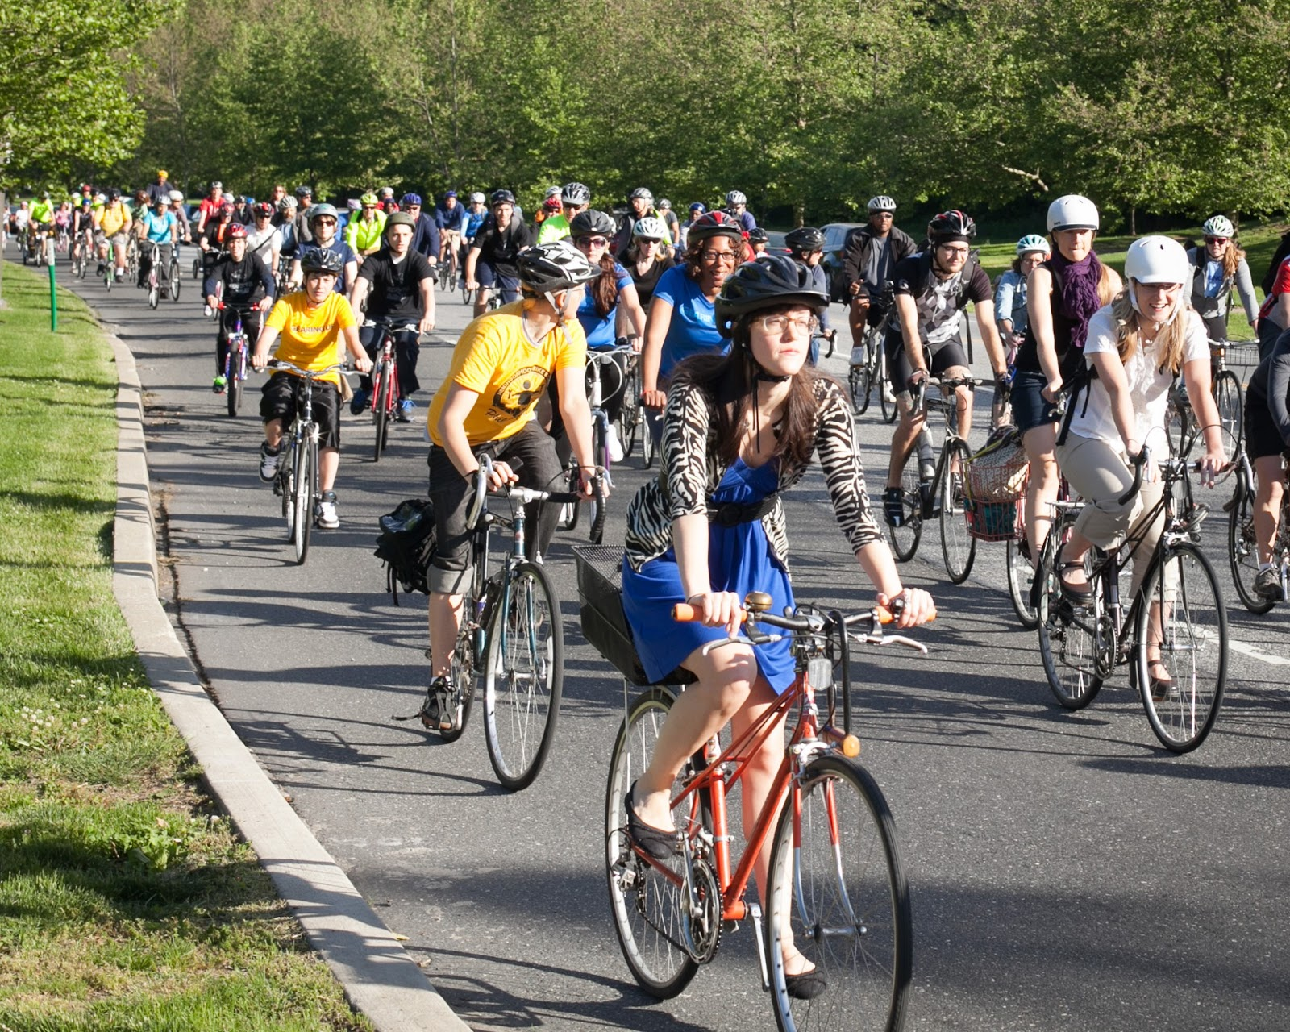
Stages of a paradigm shift
STABILITY... |  | CONSTANT INCREMENTAL MOVEMENT...
 | TRIGGER EVENT... | DRAMATIC SHIFT IN SUPPORT...
Not me and dat!
Look sense
Allyuh mad.
More cyclists = less traffic
Hmm...
Free ice cream for cyclists!
Notes:
Now this is a positive event but we saw a very similar event with a negative effect occur (free transport for school kids and seniors), which resulted in the system becoming very quickly overwhelmed without the attendant rise in revenues to support

Slide 26
Assessing the demand
What do we need/want?
THE SEVEN DEMANDS
Transit:
1. takes me where I want to go
2. takes me when I want to go
3. is a good use of my time
4. is a good use of my money
5. respects me in the level of safety, comfort and amenity it provides
6. I can trust it
7. it gives me freedom to change my plans
Notes:
Nodes,Connectivity/Routes
Frequency, Span
Speed, Delay
Fare
“Civility” - Safety, security, cleanliness, courtesy/customer service, amenities
Reliability
Simplicity, presentation

Slide 27
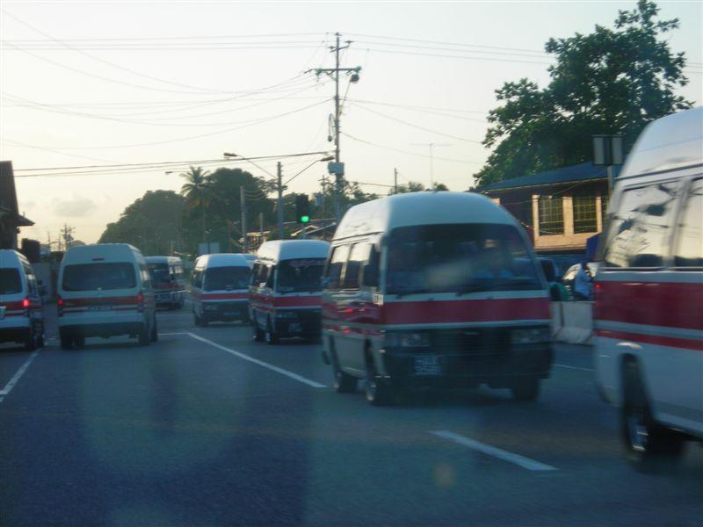
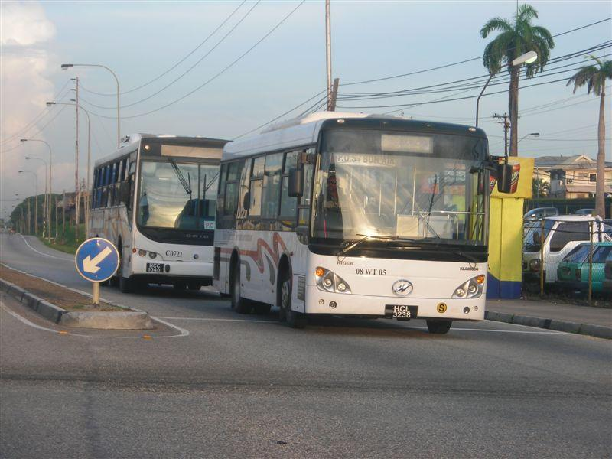
Assessing the operating conditions
What do we have?

Slide 28
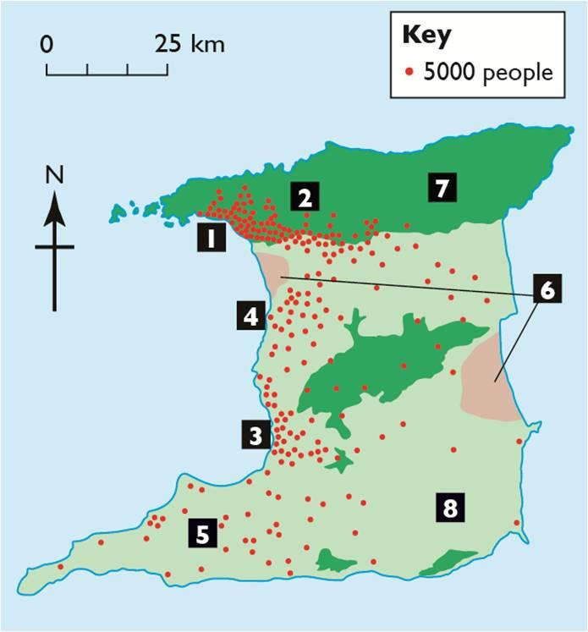
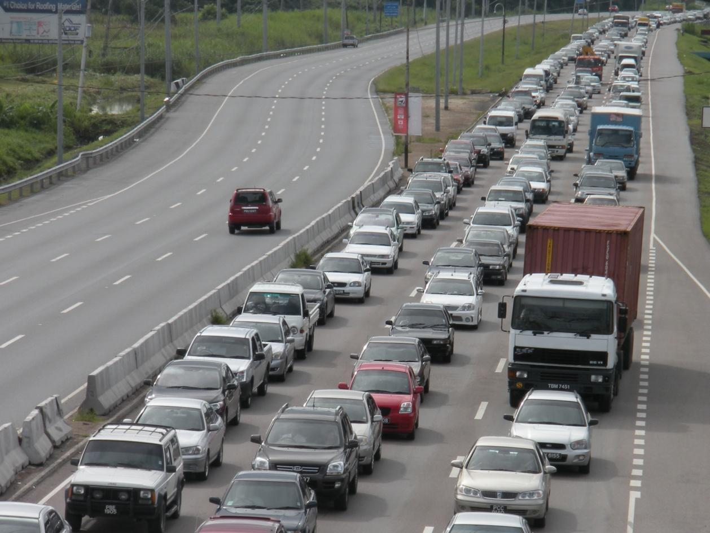
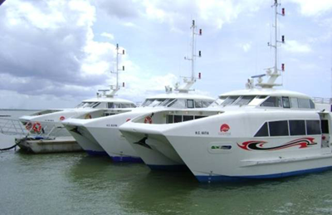
Assessing the operating conditions
What do we have?

Slide 29
Providing the supply
What can we do?
Introduce and enhance transit priority measures.
Explore alternative funding mechanisms.
Develop effective routes and schedules through research and data collection.
Provide useful and timely public information.
Operate safely and reliably.
Notes:
Utilise and expand the PBR
Lane recapture
Development of park + ride/kiss + ride facilities
Ring-fencing public funding
User funding for users and non-users of transport
Congestion charging and paid parking
Salary sacrifice and benefit schemes
Taxation of companies
Land value capture
Public/Private partnerships

Slide 30
Providing the supply
What can we do?
THE SEVEN PHASES OF A TRIP
1. Understanding
2. Accessing (at the origin)
3. Waiting
4. Paying
5. Riding
6. Connecting
7. Accessing (at the destination)

Slide 31
Conclusions
Next steps
1. Commit to change
2. Reorganise the sector
3. Invest in training, technology and resources

